Slide 1


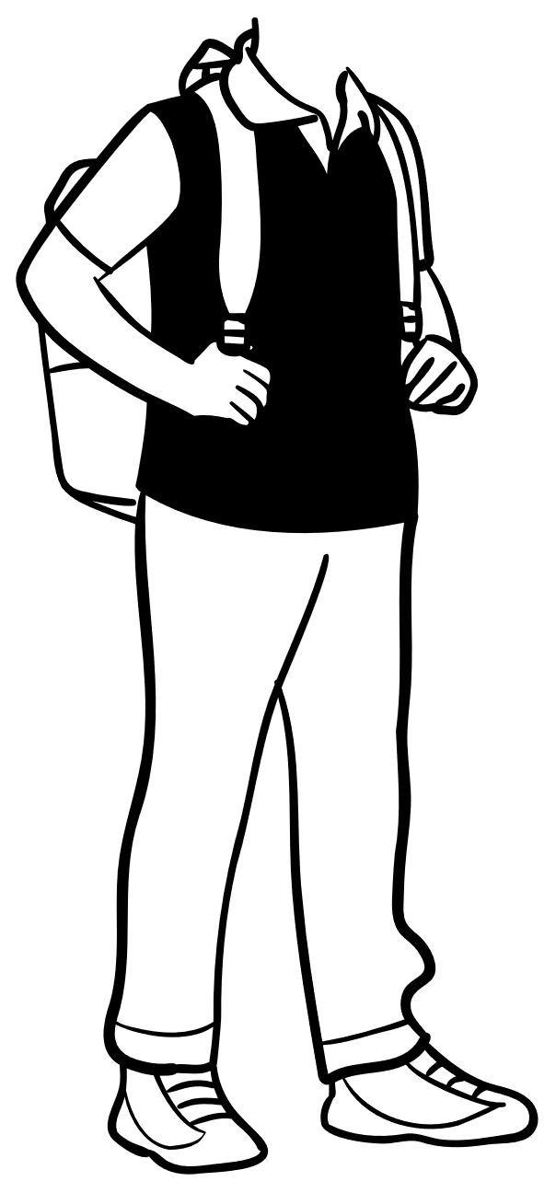

Slide 2



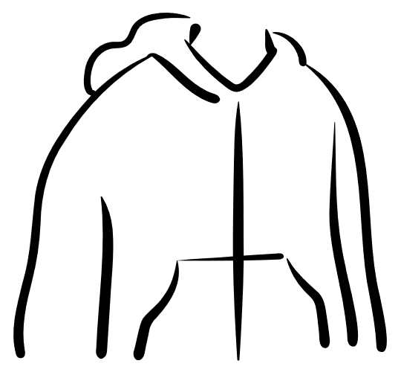


I say:
I say:
Math terms:

Slide 3
Can you tell me ___________ ?
(What information do you need?)
Why do you need to know ____?
(Repeat information requested.)
{Listen to partners response. Then locate the information on your card.}
Okay. The data says…
Problem Card:
Data Card:
I need to know because…
What else do you need to know?
Why do you need to know ____?
(Repeat information requested.)
{Listen to partners response. Then locate the information on your card.}
Okay. The data says…
Can you tell me ___________ ?
(What information do you need?)
I need to know because…

Slide 7
First Read
Summarize the scenario without using any numbers or values
Create a sketch (if appropriate)
Define the problem (no values)

Slide 8
Second Read
What are the given values and unknown values? (include units or meaning)
What is the question(s) being asked?

Slide 9
Third Read
What strategy or process do you need to use to answer the question?
What hints does the problem give to help you know how to solve it?

Slide 10
Concrete Model (picture of the problem)
Abstract Model (expressions, equations)
Given Problem
How are these models the same?
Visual Model (graph)
How are these models the same?
How are these models different?
How are these models different?

Slide 11
Your Solution Method (show your process)
Alternative Method
Alternative Method
How are these solution methods the same?
How are these solution methods different?

Slide 12
Given Response:
I agree because…
I disagree because…
Mathematical Language Used or Needed:

Slide 13
What mathematical language is used or needed in the response?

